Slide 1

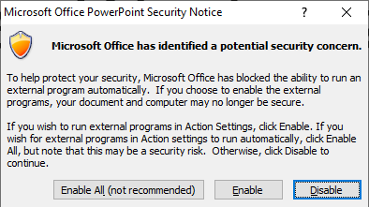
Alien Weaknesses
Action Plan: Take Back Earth
Error: This version of PowerPoint is not supported.
Please update and try again.
This presentation uses advanced PowerPoint features. Push F5 to start presentation and enable these features when prompted:

